Slide 1
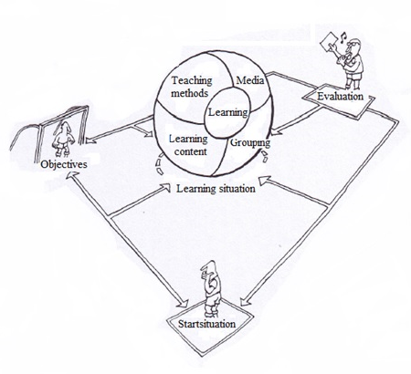
Didactic model
EKFI PLUS: Innovation through cooperation
DTM1 14062023
Frank den hartog

Slide 2
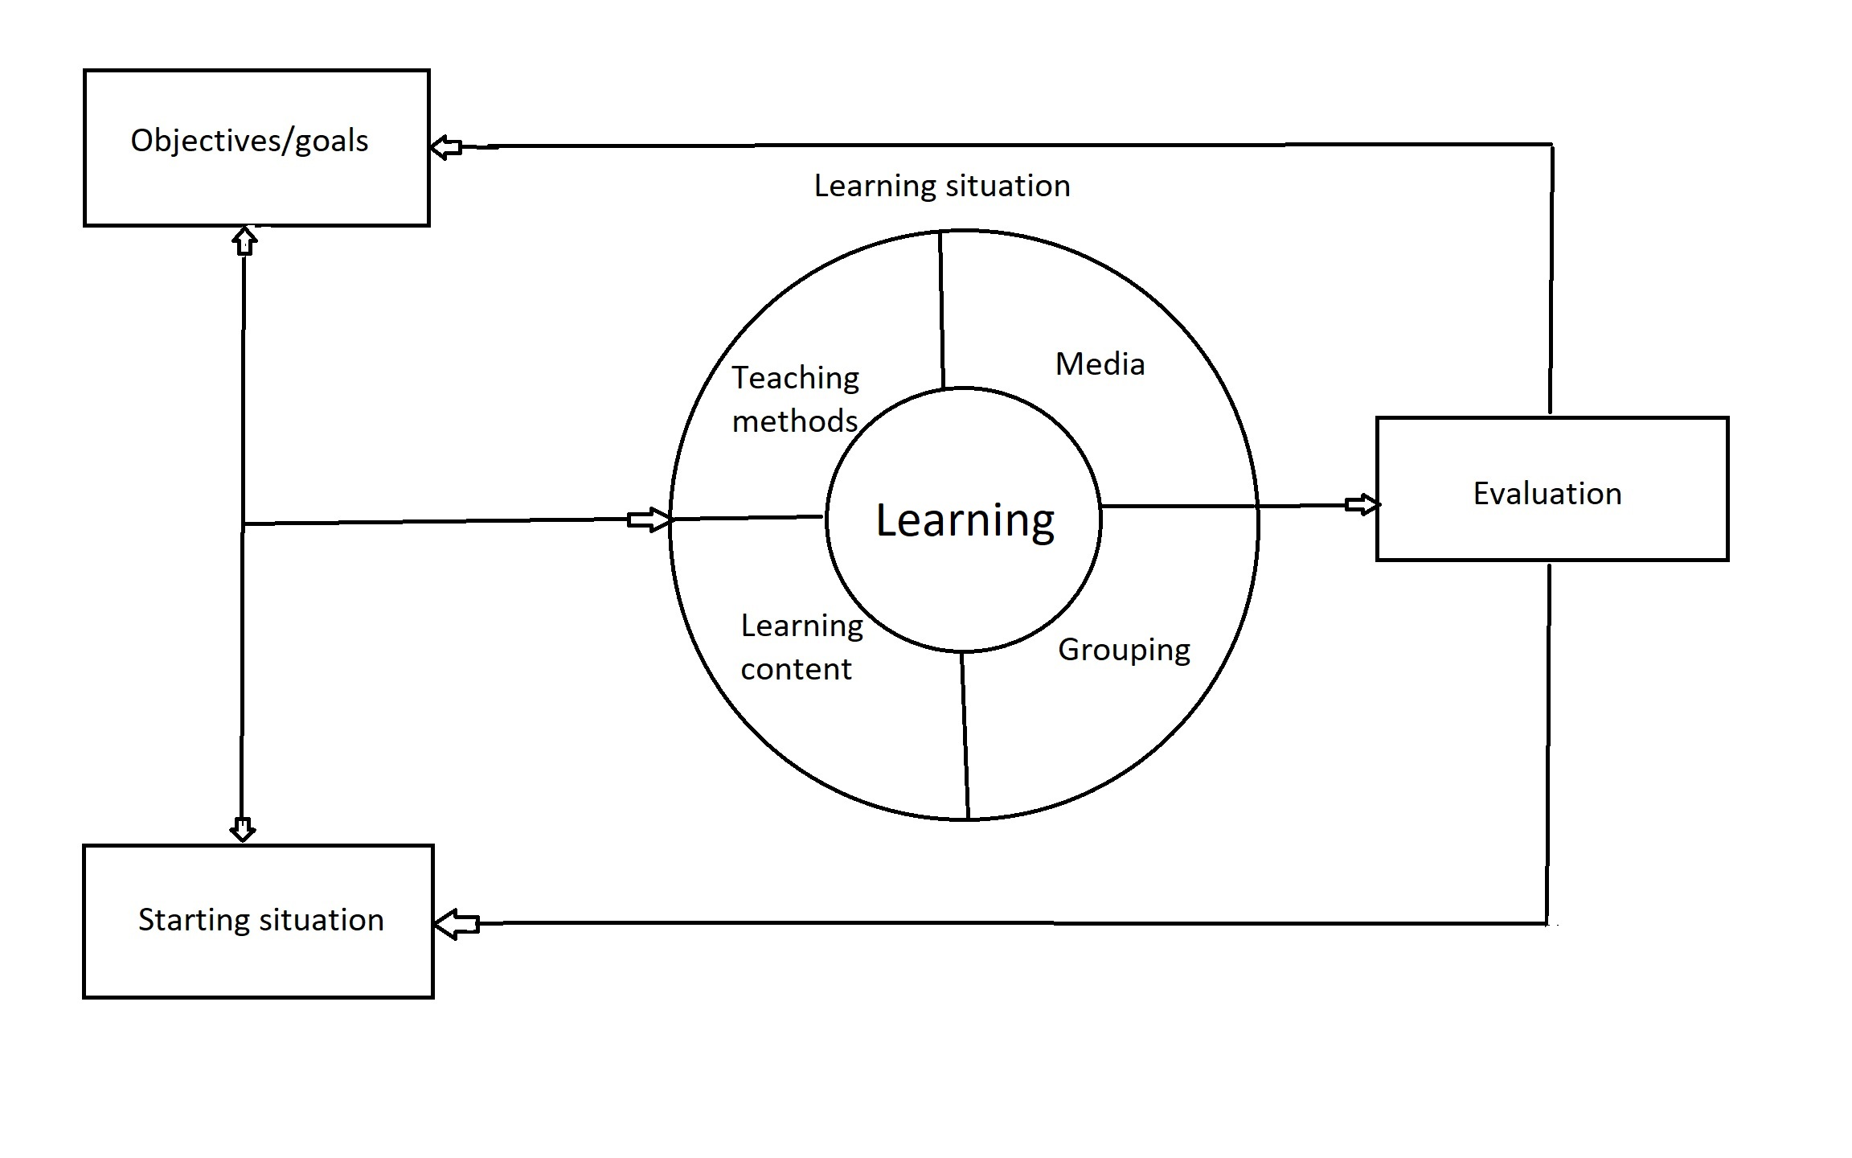
Learning is a process in which people from a certain starting situation will gain knowledge, skills and attitudes, which they will use to reach a certain set of goals.

Slide 3
Depending on the starting situation of the learner (= IST situation) and the knowledge, skills and attitude aspects necessary to successfully carry out the task (= Soll situation) the learning objectives are established.

Slide 4
In the training (= learning situation), the learning content is offered by a teacher (= teaching methods) to the student (= group form) using media.

Slide 5
Objectives
Abstract
General goals: Final objectives formulated to behavior and content.
Subgoals: Formulated in terms of final behavior. A cluster of subgoals is a general goal.
Objectives: Formulated in specific changes in behavior, such as end result of learning activities.
Cluster of objectives from a subgoal.
Concrete

Slide 6
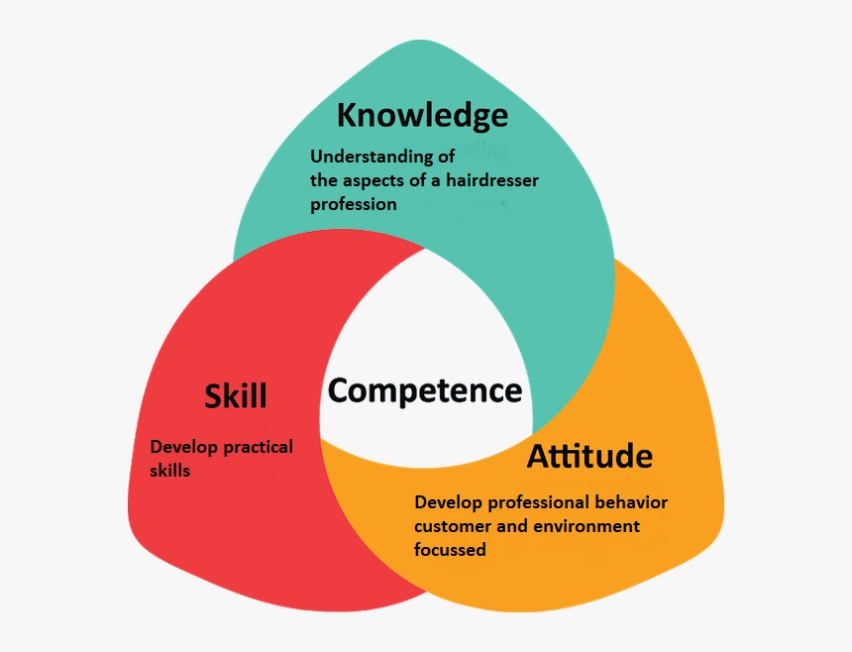
Organize objectives
1. Knowledge (cognitive)
2. Skills (psycho motor)
3. Attitude (affective goals/targets)

Slide 7
Knowledge
- Knowledge (to know): Literally reproduce.
Comprehension (understanding): To be able to use contents, to transform.
- Practice: Simply be able to choose, without the use
and/or help of knowledge on rules, principles, regulations or methods etc.
- Analysis: Reasoning, choose from options and try to reach a solution.
- Synthesis: Creative thinking: putting together the elements into a united whole.
- Criticize: Used as a result of critical thinking.

Slide 8
Skills
- Perception: Visual, tactile, taste, smell.
- Simulation: Be able to imitate the action
- Automatism: Independently perform actions.
- Application: Be able to run in new situations.
- Originality: Creatively creating new ways in dealing with
material or objects

Slide 9
Attitude
- To muster attention: Open up.
- Accepting: Be willing – acceptant.
- Willingness to respond: To respond / react to.
- Appreciation: Identify with.
- Organization of values: Values that interralate
- Character: Strongest level of internalization

Slide 10
Preparation phase 1
In the application and planning
Define goals, starting situation of the future participants. Design of the method of delivery (digital and/or physical).
Define the competences: defining the related knowledge, skills, attitudes for the target group
Rough outlines on contents of the learning material
Define the draft training schedule, level & duration of the course

Slide 11
Preparation phase 2
Discuss in the group
Goals, starting situation of the future participants EQF level
Design of the method of delivery
Competences for the target group
Rough outlines on contents of the learning material
The draft training schedule, level & duration of the course

Slide 12
Preparation phase 3
Boundaries set in partner meeting 13 June 2023
We will develop 2 courses per output 4 and 5: one on EQF level 4-5 and one on EQF level 6
Method of delivery in word documents: Through the various e-learning systems in the institutes, the developed material will be developed in Word so that it can later be uploaded into their own systems.
Competences for the target group see document website
Rough outlines on contents of the learning material
The draft training schedule, level & duration of the course: duration between 16 and 24 hours (60 minutes) interaction time with students.
Amount of pages: 60-80 pages

Slide 13
Teachers manual (per unit of learning)
Goals:
Subgoals:
Objectives:
Starting situation:
Time | What | How | Media
Introduction Core Closure

