Slide 1
EKFI PLUS: Innovation through cooperation
WP 2: Evaluation of the Educational Model (30/01/2024)
Leading organization: HELLENIC GRAPHIC-MEDIA RESEARCH LAB GRAPHMEDLAB – UNIVERSITY OF WEST ATTICA (E10031602 - EL)
Dr. Anastasios Politis, Dr. Marios Tsigonias, Dr. Gerasimos Vonitsanos, Evangelos Syrigos

Slide 2
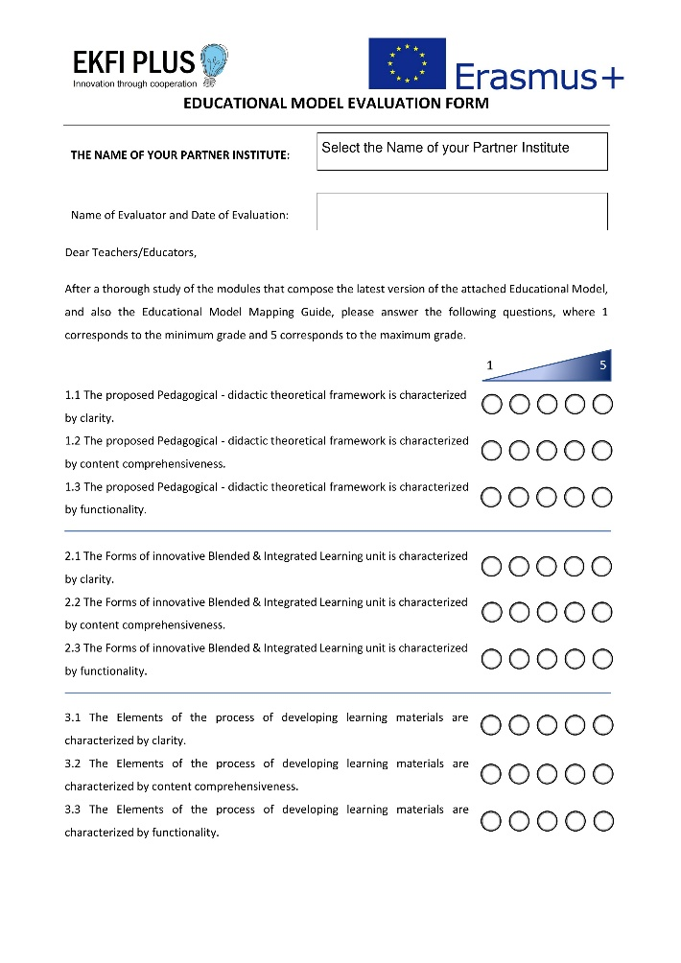
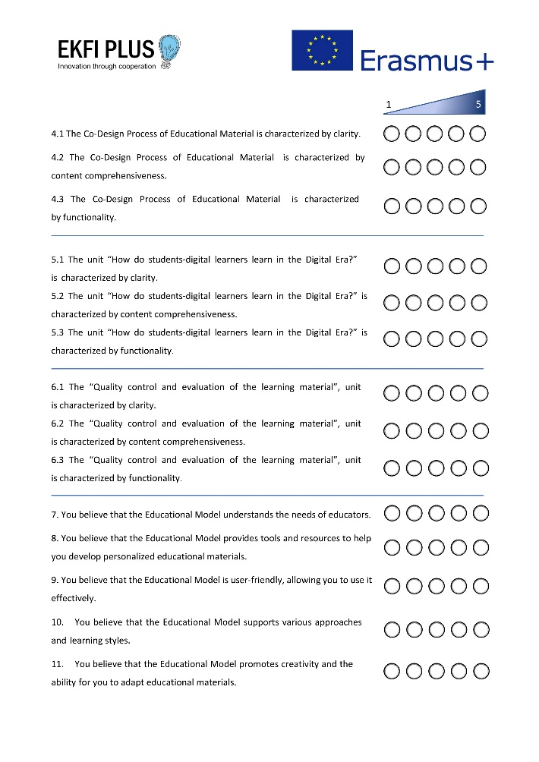
WP 2: Evaluation of the Educational Model and the Mapping Guide (30.01.2024)

Slide 3
Evaluation of the Educational Model & Mapping Guide

Slide 4
Evaluation of the Educational Model & Mapping Guide

Slide 5
Evaluation of the Educational Model & Mapping Guide

Slide 6
Evaluation of the Educational Model & Mapping Guide

Slide 7
Evaluation of the Educational Model & Mapping Guide

Slide 8
Evaluation of the Educational Model & Mapping Guide

Slide 9
Evaluation of the Educational Model & Mapping Guide

Slide 10
Evaluation of the Educational Model & Mapping Guide

Slide 11
Evaluation of the Educational Model & Mapping Guide

Slide 12
Evaluation of the Educational Model & Mapping Guide

Slide 13
Evaluation of the Educational Model & Mapping Guide Evaluation numbers: 14 people evaluated the Educational Model (N=14). Conclusions: Important Points to discuss: 1. Security and GDPR issues should be further discussed 2. Educational Model Mapping Guide seems to resolve the functionality problems of the Educational Model itself. 3. The Platform should provide more tools and functionality

