Slide 1
EKFI PLUS: Innovation through cooperation
WP 2: Educational Model (06/12/2023)
Leading organization: HELLENIC GRAPHIC-MEDIA RESEARCH LAB GRAPHMEDLAB – UNIVERSITY OF WEST ATTICA (E10031602 - EL)
Dr. Anastasios Politis, Dr. Marios Tsigonias, Evangelos Syrigos, Gerasimos Vonitsanos

Slide 2
WP 2: Educational Model An Educational Model will be developed with the core-question: “How do we develop in an effective and efficient way learning materials online and cross- borders?”

Slide 3
WP 2: Educational Model
The educational model is developed as the basis for the creation of digital tools and applications that will lead to the updating of the existing electronic platform of EKFI (ekfi.eu)
Support teachers in Europe in jointly developing new learning material on
CCI - Creative & Cultural Industries fields
Goals
Further developing the existing EKFI platform and will add features to support the development of learning material.
MAIN GOAL: Facilitate the teachers and specialists of the IPP from different countries and schools to cooperate with each other in order to create new learning material together
s

Slide 4
WP 2: Development of an educational model
Summary
Didactic model for developing learning materials
Forms of innovative Blended & Integrated Learning
Elements of the process of developing learning materials
The Co-Design Process of Educational Material
How do students- digital learners learn in the Digital Era?
EKFIPLUS - Quality control and evaluation of the learning material
 8. Educational model development (STEP BY STEP) based on ADDIE instructional design development model – Short Mapping Educational Mapping Guide

Slide 5
2. Didactic model for developing learning materials
Behaviorism
Behaviorism uses a teaching and learning system in which the pre-defined curriculum is broken down into small, clearly separated steps (stages) and organized constructively in a logical sequence,
which students can easily learn, the planned teaching.
The most important learning mechanism according to behaviorists is the reinforcement of desired behavior.
Guidance and Teaching Systems
Practice Software - Tutoring or Teaching Software
Educational games - Multimedia software
Information processing theory - Experienced Learning Systems - Neural networks

Slide 6
2. Didactic model for developing learning materials
Cognitivism
The theory of Gognitivism placed considerable emphasis on the active role of the individual in the acquisition of knowledge, emphasizing that active learning is much more rewarding than passive learning.
Τhe basic methodology for designing computer-based learning environments:
• To inform learners of what they need to achieve
• To support the construction of knowledge (representing students' ideas, understanding and performances).
• To enable explorations (access to information for comparison with other perspectives).
• To support learning through practice (simulation of real situations).
• To support the expression and connection of knowledge (mental partners)

Slide 7
2. Didactic model for developing learning materials
Constructivism
The goal of learning is to modify pre-existing knowledge
The goal of teaching is to create an appropriate and rich environment with
which the student interacts
‘Τhe most important factor affecting learning is what the student already knows. Find out and teach him accordingly’.
● Learning is an individual process of building knowledge.
● Meaning is acquired through experiences.
● Learning is not memorizing concepts or facts.
Sociocultural Theories
Practice Software - Tutoring or Teaching Systems - Neural networks
Internet applications (chat, forums, video conference)
Internet Tools for Collaboration and Communication (systems cooperative learning)
Online Games (MOOs, MUDs) Multimedia & Web Application Development Systems

Slide 8
Jerome Bruner: Discovery Learning
Learning by doing is one of the most immersive education strategies, especially if your teacher offers encouragement and immediate feedback.
Discovery Learning Systems & Environments - Investigation - Construction
Hypermedia Applications
Virtual Reality Applications
Visualization Systems
Concept Mapping Systems
Simulation Applications
Modeling Applications
Computer Based Labs
Environment Connection Devices (sensors)
Robotic Systems (Lego type)
Microcosms in specific subject matters
Programming Environments (Logo type)
Educational games or electronic games
General Purpose Software

Slide 9
2. Didactic model for developing learning materials
Humanistic theories
These theories approach learning through the perspective of personality’s development.
Carl R. Rogers: human’s behaviour is a factor stimulated by the tendencies of self-actualisation (creativity, a growing openness to experience, reliability and constructiveness, freedom of choice, etc).
Teacher’s role is not to transmit an academic knowledge "pre-made", but to propose possibilities for investigating a cognitive field, therefore to organize learning processes that are always renewed.
"We cannot teach a person directly. We can only facilitate his path to learning’’

Slide 10
3. Forms of innovative Blended & Integrated Learning
3.1. Derivatives of the Major Learning Theories
The important modern theories of learning, developed based on the scientific method - i.e. with the possibility of refutation/verification through experimentation - are not simply individual theoretical models, but constitute large currents of scientific thought.
A number of individual theories (smaller and interconnected) and models have roots in one or more of the above frameworks, analyze in a complementary way the same or different aspects of the learning phenomenon.

Slide 11
3.1.1. Blended Learning
Blended Learning is an approach to education that goes beyond traditional means of teaching and combines them with technological media such as e-learning.
A well-designed Blended Learning activity can combine the advantages of the two types of classroom

Slide 12
3.1.1. Blended Learning
 | Electronic Material | Hardware that is presented in the class | Type of Education | Description
1. | 0% | 100% | Traditional | A traditional class
2. | 1-29% | 71-99% | Teaching with the help of electronic media | Use of Websites or Online tools for some activities
3. | 30-79% | 21-70% | Blended Learning | This is considered Blended Learning
4. | 80-100% | 0-20% | Online teaching | Mostly online teaching with some live encounters

Slide 13
When should educators use Blended Learning?
If there is a group of students who are geographically distant and it would be more convenient for them to meet periodically rather than systematically.
• If they wish to create material to introduce a new section or repeat material.
• If there is a specific subject that would need multimedia for its teaching.
• If less live teaching would be helpful for them or for the students.
• If the students have many obligations and it would help them to learn at their own pace

Slide 14
Benefits for students
Adopting an integrated learning approach to education and training can have significant benefits for students, such as:
• Active participation in relevant real-life experiences
• Better understanding of content
• Linkage between the various disciplines of the curriculum
• Development of higher order thinking skills
Disadvantages of Blended Learning

Slide 15
Connectivism. The main principles.
A learning theory for the digital age that knowledge is distributed in a network of links learning is based on the possibility of constructing and traversing these networks.
• Learning is a process of connecting
• Learning may reside in non-human appliances
• Learning is more critical than knowing
• The ability to see connections between fields, ideas, and concepts is a core skill
• Decision-making is a learning process. It’s clear that technology is changing how students learn in and out of the classroom

Slide 16
4. Elements of the process of developing learning materials
The didactic model for developing learning materials contains various elements
• Learning environment
• Objectives
• Role of the teacher
• Learning activities
• Learning contents
• Learning Content Areas for the EKFIPLUS project and platform
• Learning resources/materials
• Learners
•

Slide 17
Learning environment
Learning environments include:
• the physical spaces where lessons take place (classrooms, studios, auditoriums, indoor and outdoor facilities). How other learning spaces are created and used: as - cultural spaces (theatres, art galleries, museums)
• the spaces of distance learning, where the teacher and the students do not coexist in a physical space: the home and online collaboration spaces
• the co-creation of supportive environments (professionals outside the school, parents)
• co-creation with students (creativity, well-being, etc)

Slide 18
Learning goals
General statements written from the perspective of an instructor or institution that give the general content and direction of a learning experience, and describe in general terms what a trainer or program aims to do.
That is, "The curriculum will introduce students to the major research methods of the field."
Learning objectives
Statements of what you intend to teach or cover in a learning experience.
They tend to be:
More specific than learning goals
Not necessarily observable nor measurable
Instructor-centered rather than student-centered
Useful in helping you formulate more specific learning outcomes

Slide 19
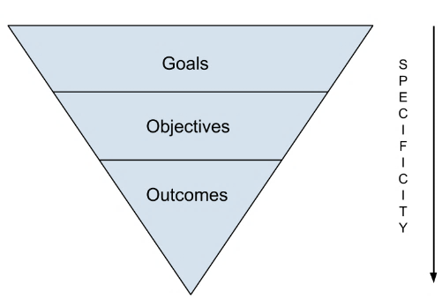
Learning outcomes

Slide 20
Learning outcomes
The totality of information, knowledge, understanding, attitudes, values, skills, competencies or behaviours a learner has mastered upon the successful completion of an education programme
Student-Centered
Measurable (they use a concrete action verb)
Meaningful
Concise (are written in short, succinct sentences).
Achievable
Formula for Writing Learning Outcomes
As a result of participating in (educational unit), students will be able to (measurable verb) + (learning statement)

Slide 21
Learning contents
(Topics, themes, beliefs, behaviors, concepts and facts)
Specific directions for organizing the learning and teaching contents
• Learning and teaching time
• Program philosophy - Shared knowledge and educational values
• Definition of the subject (what is being learned)
• Amount and structure of information provided (how much is needed and how it is organized)
• Cognitive information acquisition strategies
• Identification of learning moments (steps according to Rogers, which constitute the learning episode)
• Interests and needs of the students - The role of the trainer

Slide 22
Learning Content Areas - EKFIPLUS project & platform
The content is divided into the following subject areas.
1. Printing & Packaging
2. Entrepreneurship – Management
3. Sustainability – Circular economy
4. Digital media
5. Sign and Display
6. Digitalization – Digital Transformation – Industry 4.0

Slide 23
Learning activities
Learning activities, as the name suggests, are activities designed or
deployed by the teacher to bring about, or create the conditions for
learning.
Acquisition (1)
Inquiry (2)
Practice (3)
Production (4)
Discussion (5)
Collaboration (6)

Slide 24
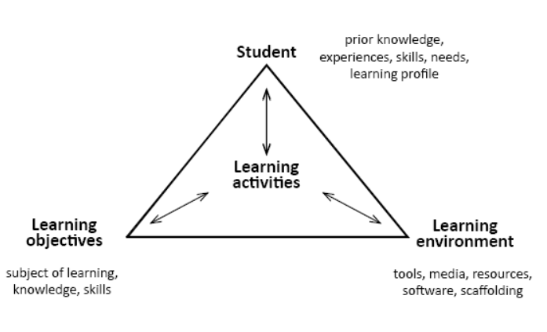
Learning activities
Learning environments include:
• the physical spaces where lessons
The framework for designing ICT-based learning activities

Slide 25
Learning resources/materials
Any resource – including print and non-print materials and online/open-access resources – which supports and enhances, directly or indirectly, learning and teaching.
The evaluation criteria of a learning resource may include the:
• relevance to the curriculum
• expectations for learning
• social concerns
• age or developmental appropriateness

Slide 26
Learning resources/materials
Open Educational Resources (OER) and Learning Practice
Open Solutions: alongside Free and Open Source software (FOSS), Open Access (OA), Open Data (OD), and crowdsourcing platforms,
https://www.unesco.org/en/open-solutions

Slide 27
Graphic arts/Graphic design Open-source Resources
• Open-source solutions & affordable software packages- Apps (indicatively)
• Graphic arts official suppliers: white-papers, audio-visual material, etc. (ESCO, Heidelberg, Adobe, Adobe Help, etc.)
• Νon-profit literary journals
• EduBlogs
• Multimedia resource banks
• Tutorials

Slide 28
5. The Co-Design Process of Educational Material
The design process of co-designing an exemplary educational material is cyclical: planning, research, draft proposals, approvals, implementation, testing, evaluation-redesign, submission.
Getting started: building the co-design team
• teachers (teacher as educational designer, teacher as digital designer, e.tc)
external members/partners for common development (learning technologists, researchers, educational developers, digital media producers number of practitioners, members from different schools, different countries
target group - participation group

Slide 29
5. The Process of Educational Material
Co-design Principles:
• Commit to working together collaboratively as a team
• Make sure all participants understand the common goal
• Co-design is inclusive. Uses feedback, advice and decisions from people with lived or professional experience.
• Be participative. Participate and facilitate others to participate in co-design activities.
All participants are responsible for the effectiveness of the process.
• Contribute to open and respectful discussion. Be empathetic, and supportive
• Be flexible. Be prepared to compromise
• Iterability is a building block of co-design. Ideas and solutions are constantly tested and evaluated, and changes/adaptations are a natural part of the process
• Respectful. All participants are considered experts and their contributions are equally valued.
• Be professional. Pursue solutions that are functional and sustainable

Slide 30
5. The Co-Design Process of Educational Material
Defining Terms of Reference (TOR)
TOR show how the object in question will be defined, developed and verified and provide a documented basis for developing a common understanding of the scope among the participants.
Participants in the co-design team have roles and responsibilities as a team and as individuals in the team.
• scope, outcomes, individual and group deliverables
• stakeholders, roles (coordinator, etc.) - responsibilities
• resource, financial and quality plans (i.e. how it will be achieved)
• structures, project planning (i.e. when it will be achieved)
• constraints, risks

Slide 31
5. The Co-Design Process of Educational Material
Defining Terms of Reference (TOR)
Identification of the training material
Co-implementation Cycle I - Material development
Co-implementation Cycle II – Tests / Revisions
Valuation
Submission & Share
Submission of the instructional material submission form (IMPORTANT)

Slide 32
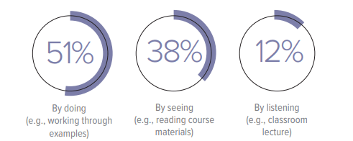
6. How do students/digital learners learn in the Digital Era?
Student studying preferences

Slide 33
6. How do students/digital learners learn in the Digital Era?
Positive response levels to ed tech tools in the classroom

Slide 34
6. Teaching Strategies for Gen Z
• Self-educate about the concept of generational differences
• Think Digital in all tasks and activities.
• Gen Z prefers active learning environments
• Encourage Collaborative - Social Learning
• Encourage research-based learning methods
• Define expectations in advance
• Break the content into short segments.
• Visualize information with aesthetically appealing educational presentations

Slide 35
6. Teaching Strategies for Gen Z
• Integrate new learning technologies and techniques (On-Demand
Learning Tools, Mobile Learning, Gamification, Video Based Training)
• You are fed with immediate information
• Provide additional help and support
• Give control to student-users with personalized - adaptive learning
• Provide educational material relevant to their daily life
• Identify the limits of multi-tasking

Slide 36
7. EKFIPLUS - Quality control and evaluation of the learning material
Copyright Issues
The submitted digital material:
• Does not infringe the privacy, copyright, trademark or intellectual property rights of any person or entity.
• In the event that any material or elements subject to third party rights have been used to create the script (e.g. film clips, images, sound, music, etc.), permission has been secured prior to submission scenario.
Parental or guardian consent required if material contains images of minors.
Available for free use, reproduction, redistribution, presentation and exploitation, provided that no commercial exploitation is intended (subject for discussion)

Slide 37
7.2. EKFIPLUS - General Specifications for the evaluation of educational materials (Requirements)
Pedagogical expediency
Pedagogical – didactic suitability
Content’s Scientific validity
Attractiveness
Flexibility
7.3. EKFIPLUS - Detailed Specifications for the development of learning material
Aesthetic perfection
Functional Suitability
Content Communication/User Interaction
7.3.1. Interface and Navigation
7.3.2. Learner Assessment

Slide 38
7.4. EKFIPLUS - Detailed specifications based on material type requirements
Audio-visual material - Video or audio clip (if required)
Educational game
Experiment/simulation
Visual material: Diagrams, tables, photographs, images, graphics, illustration, info-graphics (if required)
Online and Offline Presentations

Slide 39
7.5. EKFIPLUS - Technical Guidelines for upload educational material
7.5.1 Application of international standards
7.5.2 Specifications and Guidelines (about:)
text files/ page layout/ extensions
data files/gis
Video files
image files – 3d/ raster/ vector/ cad/ disk image
database files
executable files
game files
web files
system files
compressed files
developer files

Slide 40
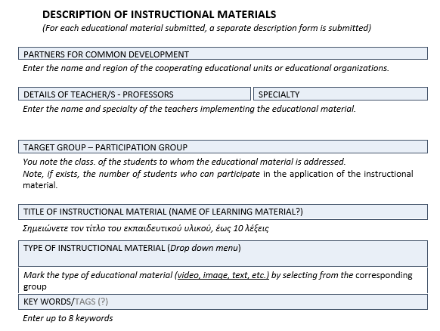
INSTRUCTIONAL MATERIAL SUBMISSION FORM (I)

Slide 41
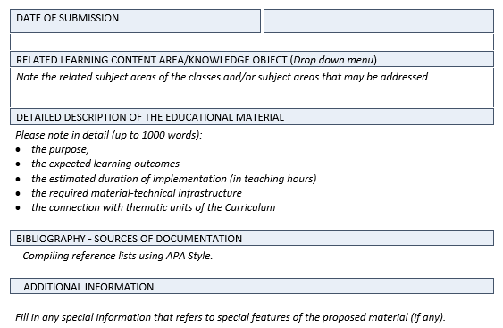
INSTRUCTIONAL MATERIAL SUBMISSION FORM (II)

Slide 42
8. Educational Model Mapping Guide
A short Mapping Guide of the Educational Model was constructed to assist teachers and trainers to study and implement the detailed Educational Model when they co-design Learning Material.
It refers to the section of the detailed Educational Model where all the scientific and technical details concerning each phase of their work, are described
In this way, the production of the Learning Material can be carried out in a systematic and step-by-step manner and in full agreement with the detailed Educational Model.
The short Educational Model Mapping Guide should be hyperlinked (point by point) to the detailed Educational Model (html – Peter?)

