Slide 1


IC STAND at DRUPA 24
STAND:18-01-2024

Slide 2
IC Participation at DRUPA 2024
Main Exhibitor:
IC- International Circle of Educational Institutes of Graphic-Media Technology and Management
Main Co-exhibitors:
HELGRAMED - Hellenic Union of Graphic Arts & Media Technology Engineers
iarigai - the International Association of Research Organizations for the Information, Media and Graphic Arts Industries
Co-exhibitors to be listed

Slide 3


IC Participation at DRUPA 2024 CONCEPT – MOTTO
Where Industry meets
Education and Research
All logos of all co-exhibitors

Slide 4
IC Participation at DRUPA 2024 CONCEPT – Wall Poster 1
Where Industry meets
Education and Research
All co-exhibitors
Plus images – design by HELGRAMED team

Slide 5
Drupa
Halls

Slide 6
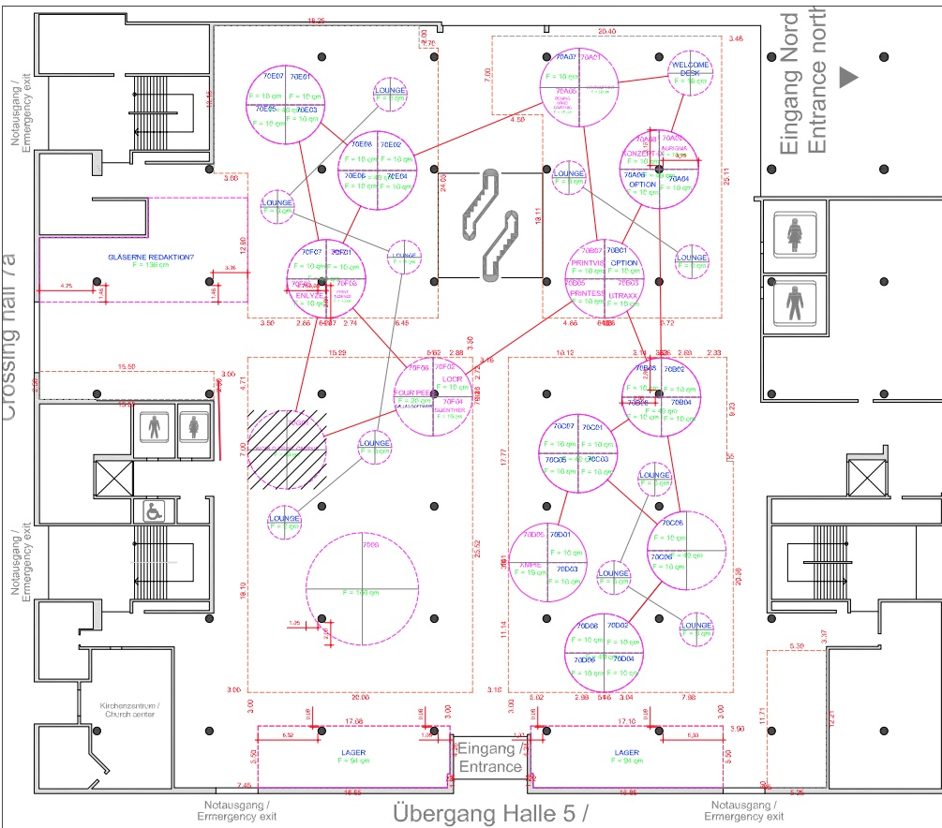
IC Stand:
dna - 7.0
G01

Slide 7
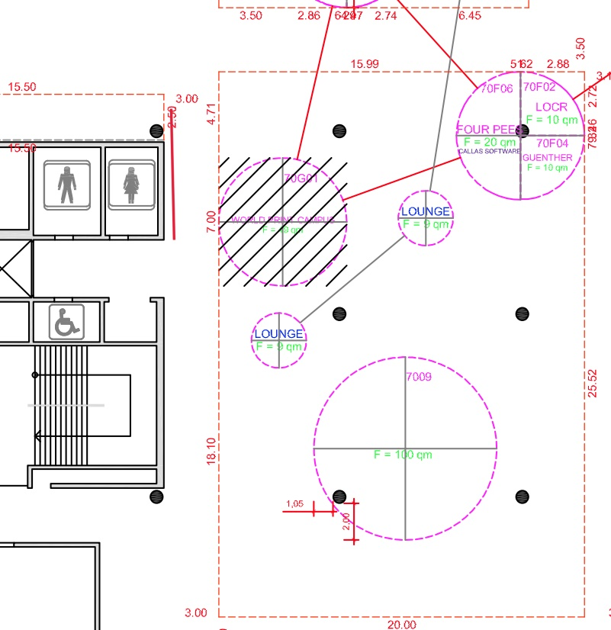
IC Stand:
dna - 7.0G01

Slide 8
Stand space distribution
¼ IC – iarigai
¼ helgramed
¼ Other co-exhibitors - Universities
¼ TV and seminar space

Slide 9
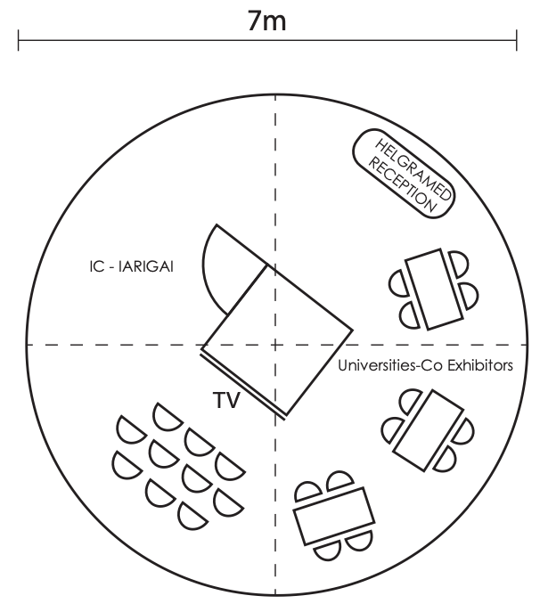
IC stand
7.0 G01 - plan

Slide 10
Equipment to be asked by Messe Duesseldorf Benedikt
One lockable storage room in the middle 1,5x1,5 meters
TV screen with stand: To be provided by Gunter HdM
22 chairs in total (10 for the seminars, 12 for the tables)
One reception desk
Four tables
Four Lockable cabinets (vitrines)
Carpet
Power outlets
Storage room outside the stand – Check on the OOS
Free entrance tickets – two per exhibitor and each co-exhibitor
What else?

