Slide 1
EGIN Final Seminar November 2-3, 2023
EKFI Plus Project (2022-2024)
Lex Bergers (Stivako)

Slide 2
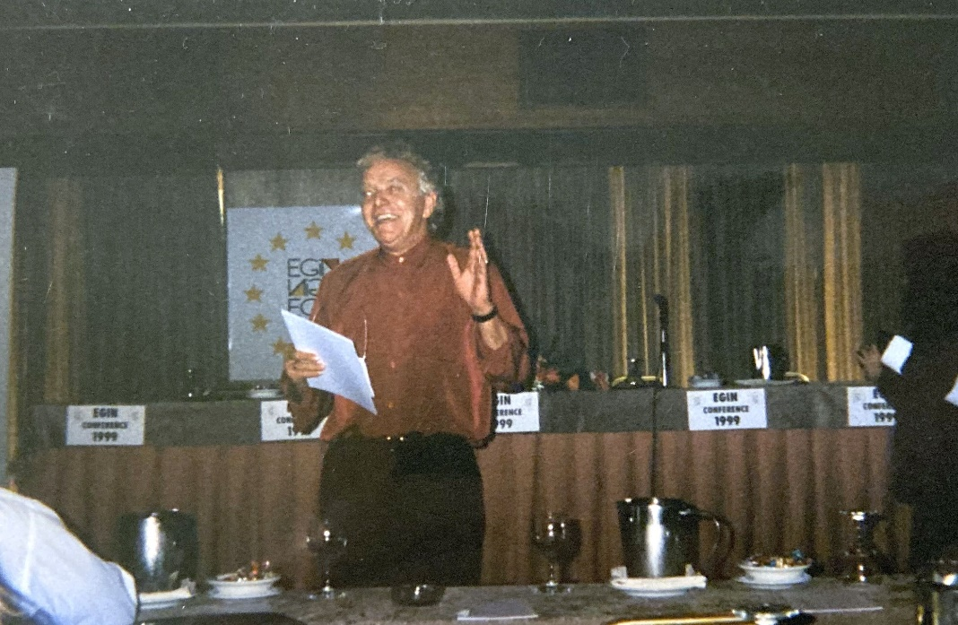
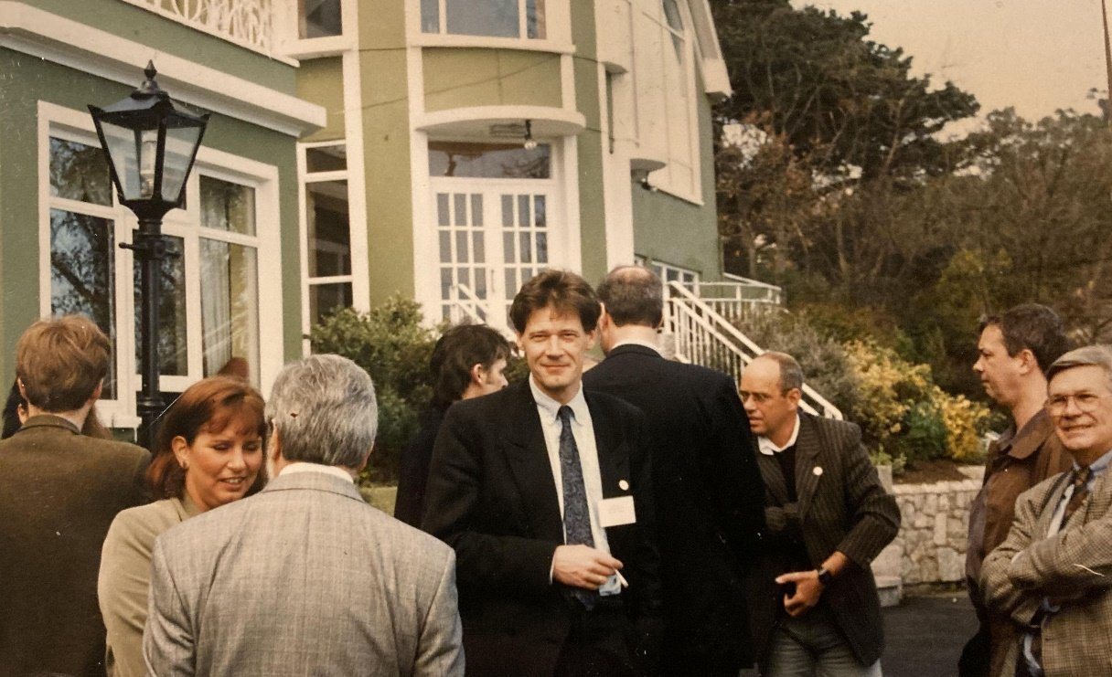
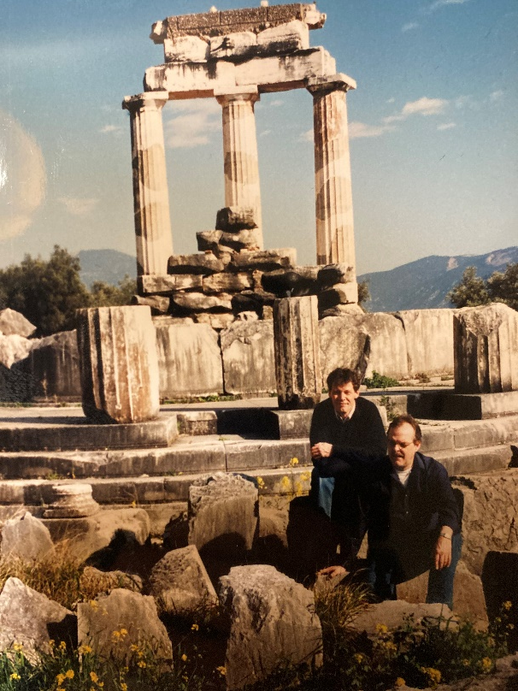
Wim Visser
My first EGIN-meeting 1997, Dublin
Delphi, with Rense (1998)
Notes:
Activities include among others

Slide 3
Partners EKFI Plus
STIVAKO, The Netherlands
Arteveldehogeschool, Belgium
GRAPHMEDLAB-UNIWA,Greece
Tallinn Polytechnic School, Estonia
Muldis, The Netherlands
Escola Algueró, Spain
Notes:
Stivako is the coordinator

Slide 4
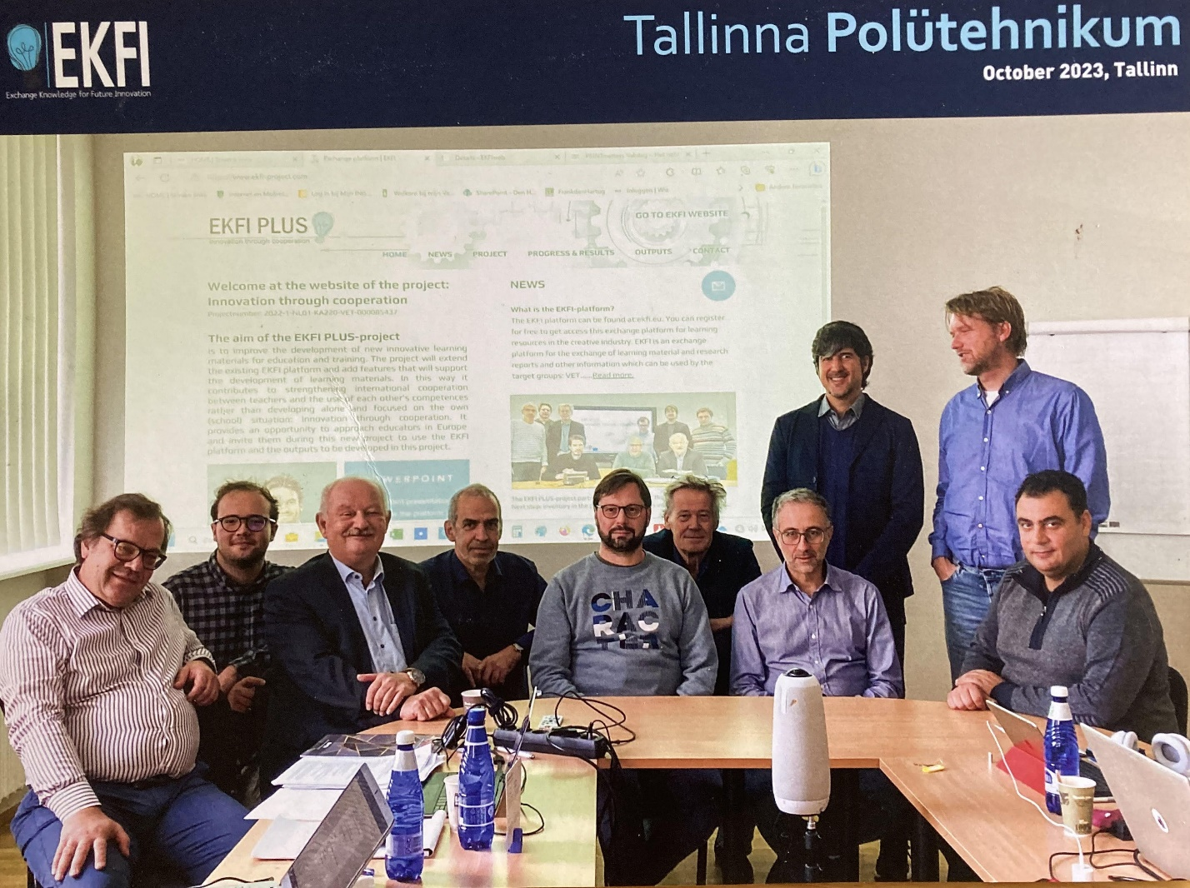
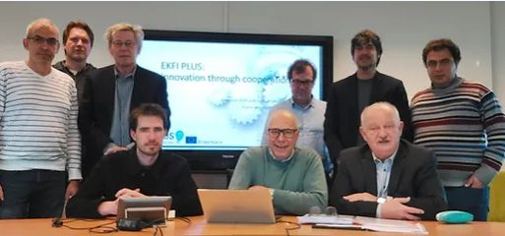
Partners
Notes:
Stivako is the coordinator

Slide 5
What is EKFI-Plus?
EKFI stands for: EXCHANGE KNOWLEDGE FOR FUTURE INNOVATION
EKFI is a project for creating an exchange platform, to facilitate exchange and development of learning/research material/content.
The project is focusing on learning material for the Creative and Cultural Industries (CCI)
Notes:
Two main problems that arise in the cultural and creative industries

Slide 6
Why EKFI-Plus?
New challenges for the education in the Creative and Cultural Industries
New and/or alteration of learning material
Learning material is produced in many countries in Europe - Need to exchange learning material instead of doing it per country
Improve learning material via exchange of courses and modules
An Exchange platform can be a solution to solve these problems
Notes:
Two main problems that arise in the cultural and creative industries

Slide 7
The main objective of the EKFI project
to create an Exchange platform to facilitate the availability and shared development of innovative learning material/content
The scope and goals
- to exchange (learning) material between platform participants
- to let teachers develop together learning material
- to improve sharing of knowledge
- to create an active sharing community

Slide 8
Fields of Knowledge
- Typography & Layout - Graphic & web design
- Photography - Premedia | Prepress
- Printing - Finishing
- Packaging -Web & Mobile Technology
- Gaming - Audiovisual techniques
- Other technologies - Marketing
- Management
- Quality & standardization
- Health & safety
- Sustainability & Environment
- Other

Slide 9
Target groups
• Vocational and Higher Education: teachers and their management • Small and Medium-sized Enterprises (SME’s)
Also:
• Social partners
• Consultants related to the (print) media creative and communication industry
• Sector organizations

Slide 10
The outputs of the project
• Workpackage 1: Projectmanagement
• Workpackage 2: Inventory and Educational Model
• Workpackage 3: Online system (Platform)
• Workpackage 4: Learning Material ‘Mixed Media’
•Workpackage 5: Learning Material ‘Circular Economy’
Important: Dissemination!!
Notes:
Activities include among others

Slide 11
The outputs of the project
Workpackage 2: Inventory and Educational Model
Step 1: Define Co-Design Team
(Initial Idea, Approved Idea, How to coöperate, work-flow plan, required material/technical infrastructure, etc.)
Step 2: Analysis Stage elements
(Current situation, target groups, what learning theory, , knowledge gaps, needs, goals/learning outcomes, existing training/education, etc)
Notes:
Activities include among others

Slide 12
The outputs of the project
Workpackage 2: Inventory and Educational Model
3. Design Stage Elements (the How)
Type of learning material, Planning, Time indication, Costs, Visual design elements, Content-excercises, UI-design, Media selection, etc.
Notes:
Activities include among others

Slide 13
The outputs of the project
Workpackage 2: Inventory and Educational Model
4. Development Stage Elements (the What)
Creating the material: text, storyboards, visuals, prototypes, assignments, tests, scipts/code, design modifications, formative evaluation…
Notes:
Activities include among others

Slide 14
The outputs of the project
Workpackage 2: Inventory and Educational Model
5. Implementation Stage Elements (to share with students)
(Help-text, train the trainers, training in new tools, delevering material to learners, formative evaluation)
Notes:
Activities include among others

Slide 15
The outputs of the project
Workpackage 2: Inventory and Educational Model
6. Evaluation Stage
Summative evaluation, did we meet the goals?, feedback.
Notes:
Activities include among others

Slide 16
The outputs of the project
• Workpackage 1: Projectmanagement
• Workpackage 2: Inventory and Educational Model
• Workpackage 3: Online system (Platform)
• Workpackage 4: Learning Material ‘Mixed Media’
•Workpackage 5: Learning Material ‘Circular Economy’
Important: Dissemination!!
Notes:
Activities include among others

Slide 17
Workpackage 3: Online System Let’s have a look…. https://www.ekfi-project.com/ https://ekfi.azurewebsites.net/
Notes:
Activities include among others

Slide 18
Workpackage 4 & 5: Learning Material Two Subjects: - Mixed Reality in Print, Sign and Packagingmedia - Circulair Economy in Creative Industry (from entrepeneural/management perspective)
Notes:
Activities include among others

Slide 19
Be an user of the system, register now! It’s easy…. P L A T F O R M The web adress of the online https://ekfi.eu https://ekfi.eu/,
Notes:
Activities include among others

Slide 20
Thank you EGIN for all these wonderful years…..!
Notes:
Activities include among others

