Slide 1
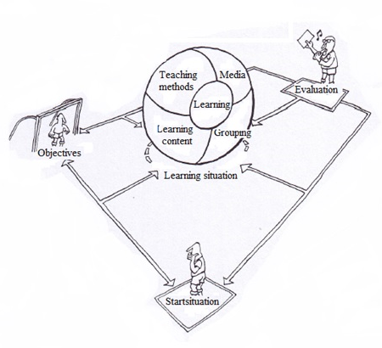
Status WP4 Circular economy
EKFI PLUS: Innovation through cooperation
Frank den hartog

Slide 2
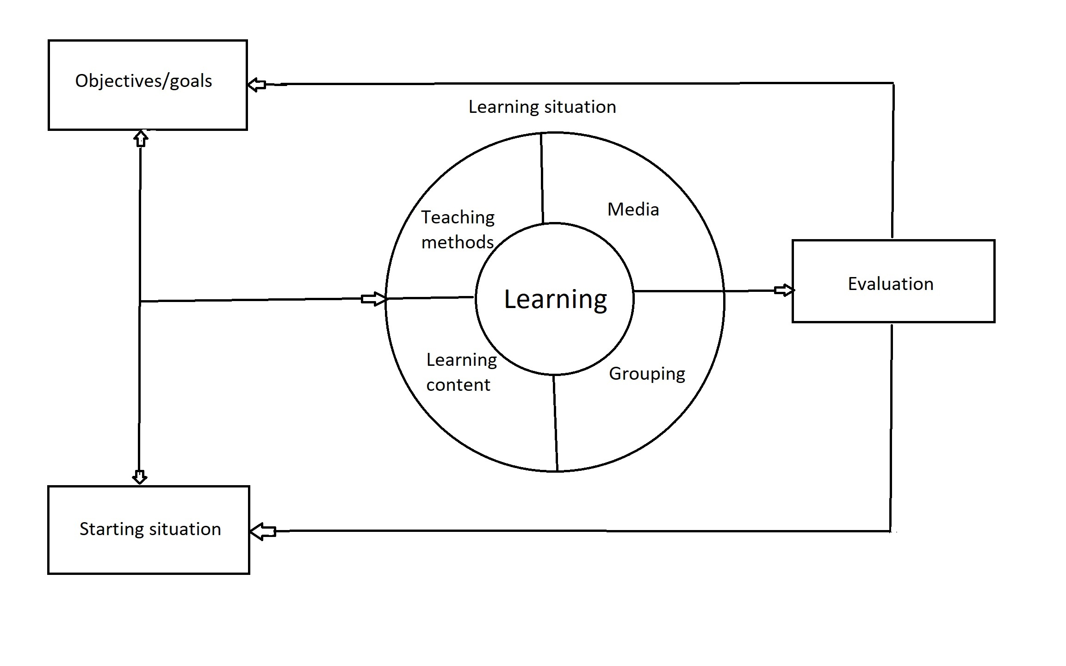
Learning is a process in which people from a certain starting situation will gain knowledge, skills and attitudes, which they will use to reach a certain set of goals.

Slide 3
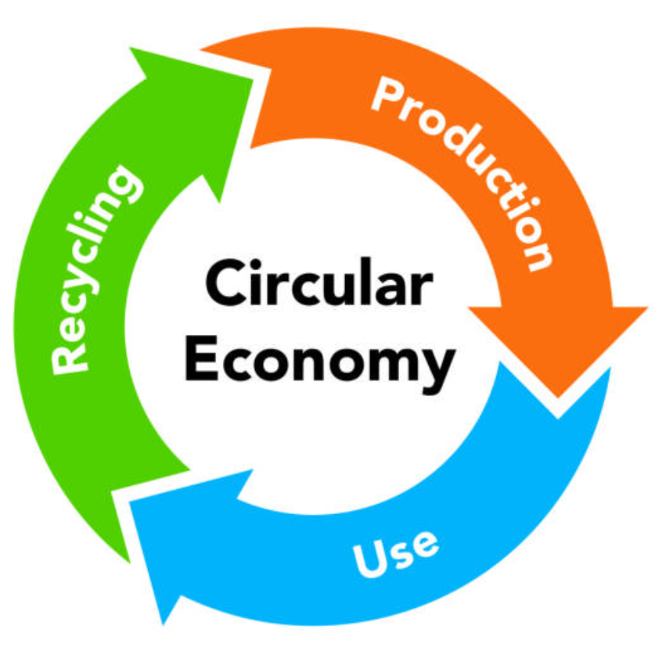
Circular Economy
Goals:
Have knowledge of Circular Economy (CE) and its significance in society in various fields
Have knowledge of the meaning and functioning of CE in the communication sector
Have knowledge of behavioural change processes needed to influence behaviour
Know the CE legislation for companies and be able to apply it within the company
Be able to apply CE methodology within the company, recognise and solve problems
Be able to cooperate with other companies on CE at business parks
Being the interlocutor of authorities in the field of CE

Slide 4
Circular Economy
Starting situation of the future participants : EQF level 4 and 5 VET 4 and HE 1
Design of the method of delivery: Studentbook 60 pages, teachers manual/ toolkit No e-learning system
Studentbook for VET & HE. Assignments different
Competences for the target group: (See form competences)
Professionalism
Analytical skills
Decisiveness
Flexibility
Organization skills
Persuasion

Slide 5
Circular Economy
Rough outlines on contents of the studentmanual:
nr | Subject CE | Time hrs 60min | Developer Reader
1 | Introduction | 3 | Ivar Kaisa Est
2 | Policy | 1 | Evangelos Makis GR
3 | Certification | 1 | Bianca Frank NL
4 | Overview chain | 2 | Makis GR Bianca NL
5 | Raw material | 2 | Bianca/Frank NL Bart B
6 | Circular Design | 3 | Bart B Makis Gr
7 | Production Premedia | 1 | Jannes B -
8 | Production Fysical | 1 | Miguel Teacher 2 SP
9 | Logistics | 3 | Teacher 2 SP Miguel
10 | End user behavior | 3 | Kaisa Ivar Est
11 | Green marketing | 1 | Frank NL -
 | Total | 21 hrs 60-80 pages 7 pages per chapter

Slide 6
Teachers manual (per unit of learning)
Time | What | How | Media
Introduction Core Closure
Goals:
Subgoals:
Objectives:
Starting situation:

Slide 7
Circular Economy
Status of development of the learning material:
nr | Subject CE | Time hrs 60min | Studentman | Teachersman | Powerpoint
1 | Introduction | 3 | yes | yes | yes
2 | Policy | 1 | yes | yes | yes
3 | Certification | 2 | yes | yes | yes
4 | Overview chain | 3 | yes | - | -
5 | Raw material | 1 | yes | yes | yes
6 | Circular Design | 3 | yes | yes | yes
7 | Production Premedia | 2 | yes | yes | yes
8 | Production Fysical | 2 | yes | - | -
9 | Logistics | 2 | yes | - | -
10 | End user behavior | 3 | yes | yes | yes
11 | Green marketing | 1 | yes | yes | yes
 | Total | 21 hrs 60-80 pages 7 pages per chapter

Slide 8
Circular Economy
Next steps:
Discussion, improvements, adjustments etc PM and DTM
Adjustments & finalizing before 28 02 2024
Translation in Dutch, Estonian, Spanish
Testing in the classroom in April/May 2024
Upload on platform
Evaluation Educational model and platform application
Final presentation in Greece

